Slide 1
Dijkstra’s Shortest Path Algorithm

Slide 2
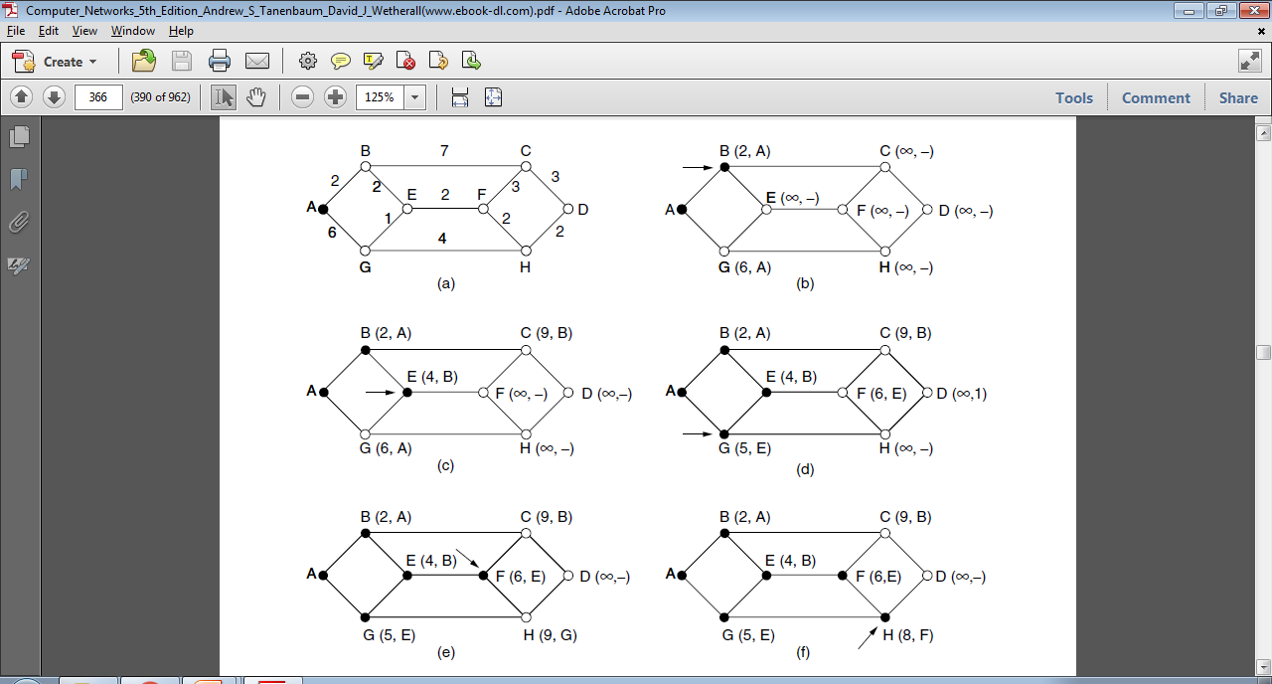
Graph 1

Slide 3
Graph 2
5
6
A
C
E
7
5
3
6
2
2
1
B
D
F
G
2
3
1

Slide 4
Graph 3
13
B
F
3
8
6
5
2
H
A
D
3
6
2
1
G
2
C
5
E
1

